Slide 1

Multi-Agent Personal Financial Portal
Team Members: Abdulaziz, Hafsa Nawaz, Grace Sam, Riddhima Singh

Slide 2

Pathway to Problem Statement

Slide 3

User-Centric Focus
Underserved audience for financial tools is ordinary consumers
Gap in Existing Tools
Need for simple cashflow tracking and savings planning

Slide 4

Solution

Slide 5

Multi-Agent Personal Financial Portal
The portal is designed to help users with:
Short-term savings (e.g., saving $10,000 in 12 months)
Long-term investment planning (e.g., retirement, wealth accumulation)
Dynamic monthly budgeting based on real transaction data

Slide 6
Tool Demo

Slide 7
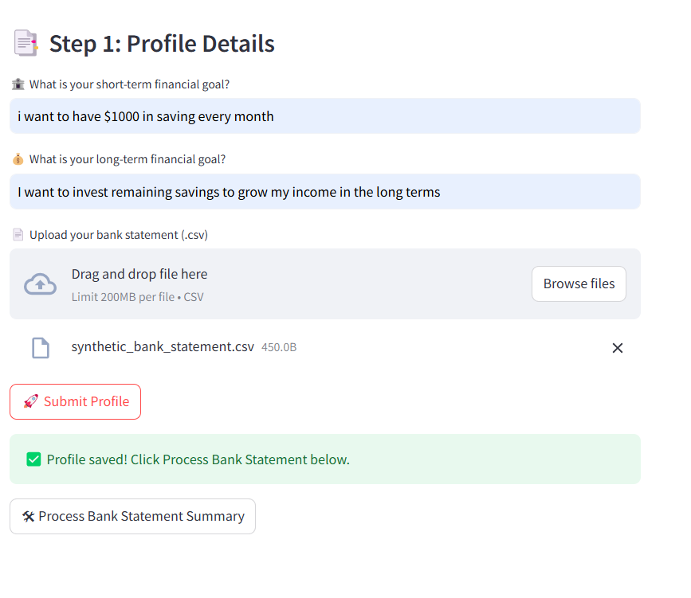
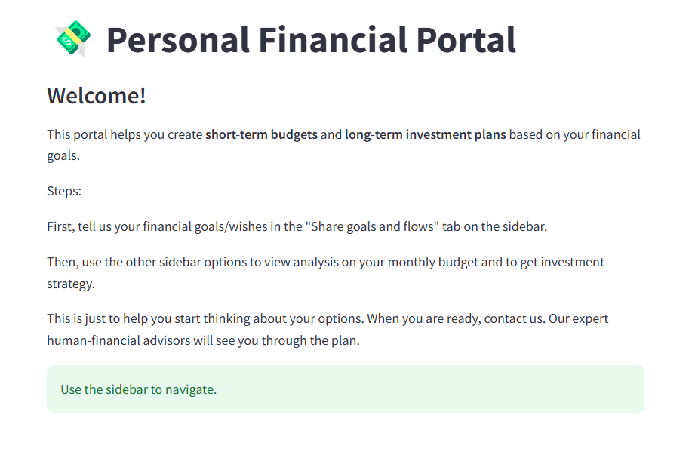
Home page - > User submits profile details

Slide 8
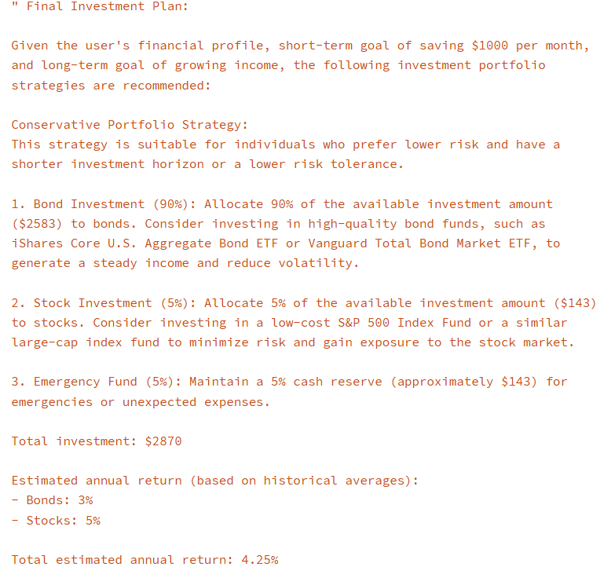
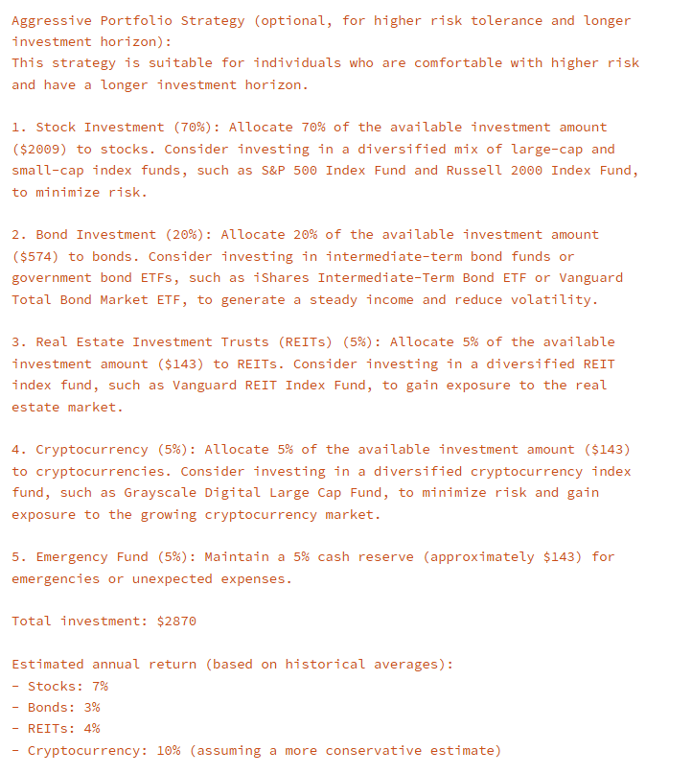
Investment option: Conservative & Aggressive
Back

Slide 9
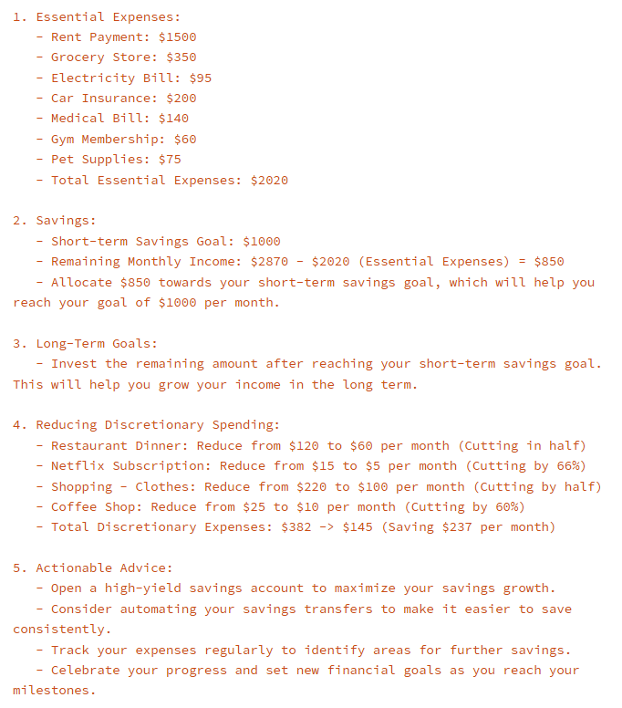
Budget Plan
Back

Slide 10
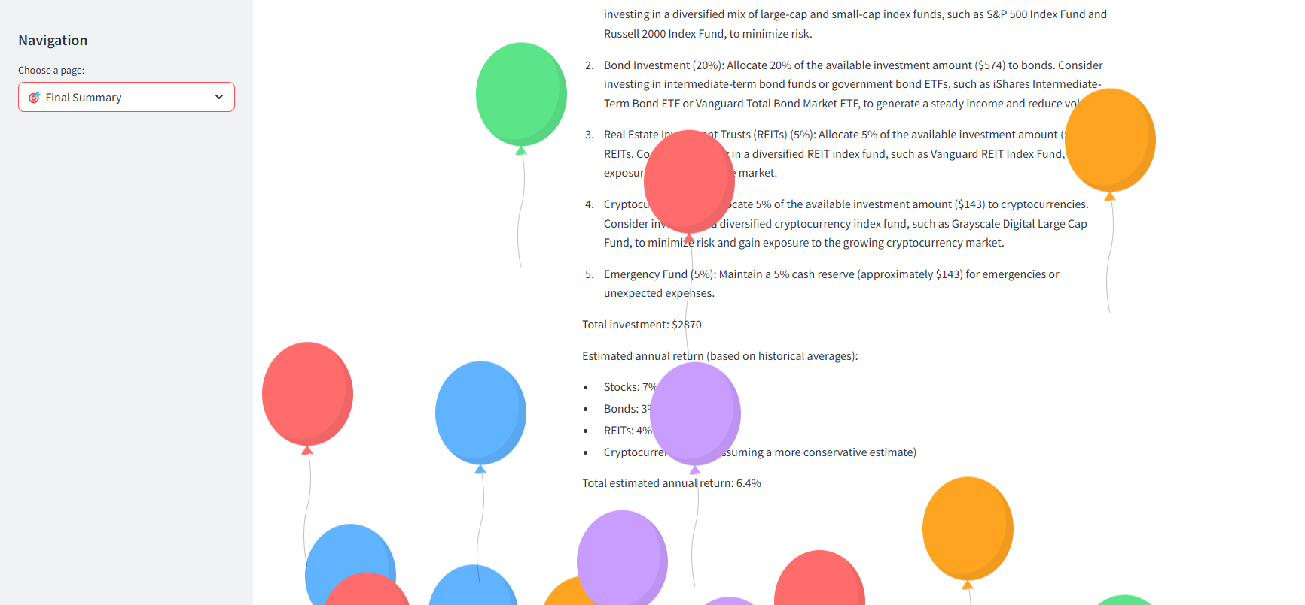
Landing Page – Investment + Budget Advice

Slide 11
Design Process
Agent-Based Modular Workflow
Design Patterns Implemented
Technology Choices

Slide 12
Agent-Based Modular Workflow
The portal is built as a multi-agent system, with each agent specializing in a specific financial task but collaborating through a streamlined workflow:
User Inputs & Sales Agent
Budget Planner Agent
Investment Planner Agent
Reviewer and Refiner Agents
Final Summary Display

Slide 13
Design Patterns Implemented
Multi-Agent Collaboration Pattern: This pattern facilitates the decomposition of complex tasks into subtasks, each handled by different agents, promoting modularity and scalability
Planning Pattern: This pattern enables agents to formulate and execute multi-step plans, allowing for dynamic and goal-oriented behavior
Reflection Pattern: This pattern allows agents to assess their own performance, facilitating self-improvement and error correction
Tool Use Pattern: This pattern enables agents to extend their functionality by integrating external tools, allowing for more informed decision-making
User Proxy Pattern: This pattern allows an agent to represent the user within the system, managing tasks and communications to achieve user goals

Slide 14
Technology Choices
Autogen: Chosen for its robust multi-agent orchestration, despite higher setup complexity compared to no-code tools.
Streamlit: Used for the user interface due to its simplicity and Python integration.
Open-source LLMs: Mistral-7B was selected for its balance of cost and capability.

Slide 15
Key Features

Slide 16
Accessible AI Advisory: Advice is clear and actionable, avoiding complex financial jargon.
Short-Term and Long-Term Planning: Supports both immediate savings goals and long-term investment strategies.
Dynamic Budgeting: Provides spending and saving advice based on actual user transaction data.
Automated Multi-Agent Validation: Plans are reviewed and refined by multiple agents to ensure quality and reduce risk of poor recommendations.
User Agency: Offers multiple options (e.g., aggressive vs. conservative portfolios) and explanations, empowering users to make informed decisions.
Ethical Safeguards: Reviewer and refiner agents help mitigate risks of hallucination and poor advice.
Human-Centered Design: Emphasizes usability, transparency, and support for real human needs, not just technical correctness.

Slide 17
Lessons Learned

Slide 18
Agent Patterns Require Careful Coordination: Implementing patterns like Critiquing and Refinement required thoughtful state management and agent communication.
Tool Maturity Matters: Open-source LLMs are cost-effective but require careful prompting; fine-tuning is a future need.
Human Oversight Remains Important: Even with advanced AI, human review and oversight are essential for trustworthy financial advice.

Slide 19
Summary The project delivers a modular, agentic AI-driven financial planning portal that bridges the gap between everyday cash flow management and long-term investment planning. It leverages advanced agent design patterns, prioritizes accessibility and ethics, and demonstrates the real-world challenges and responsibilities of building AI for personal finance.

Slide 20
Thank you

Slide 21
Questions?

Slide 22
References
The code, report and presentation content was created using GenAI with human oversight.
Chat history –
https://www.perplexity.ai/search/project-abm-BhDvJyo9RnSlZXItll.moQ
https://chatgpt.com/share/680eeb59-89c8-8007-8311-4333bc39c573

